Slide 1
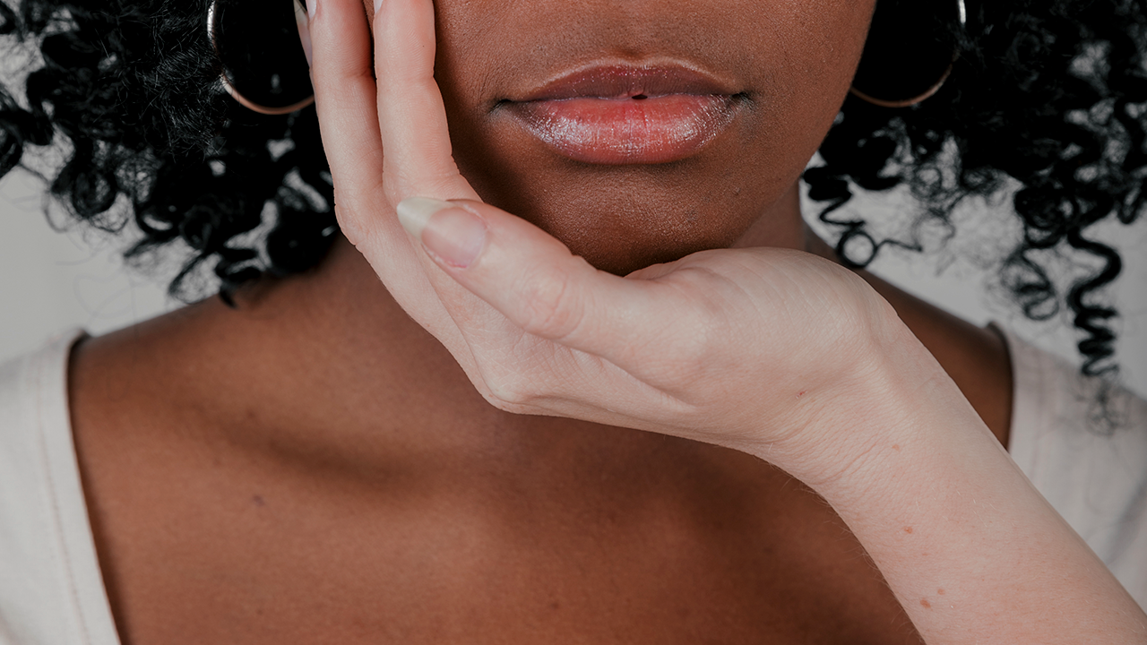
ShadeFusionBW:
05/02 Team 2
Dual-Tone Foundation Matching Algorithm
Dillanie Sumanthiran,
Harshini Donepudi, Kimia Naeiji, Priyanshi Gupta

Slide 2
01
Introduction & Background

Slide 3
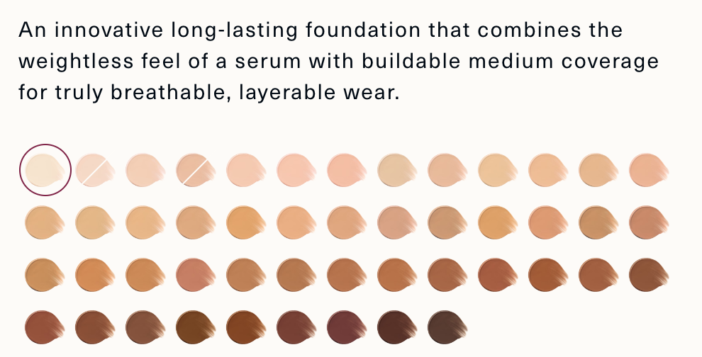
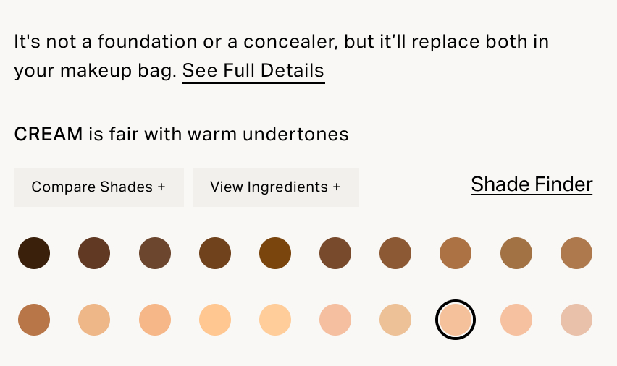
The Status Quo of Foundation is acceptance of lack of representation
The makeup industry is filled with a multitude of foundation brands, each with their own unique formulas
Many brands trend, yet often, individuals aren’t able to use those brands due to lack or representation

Slide 4
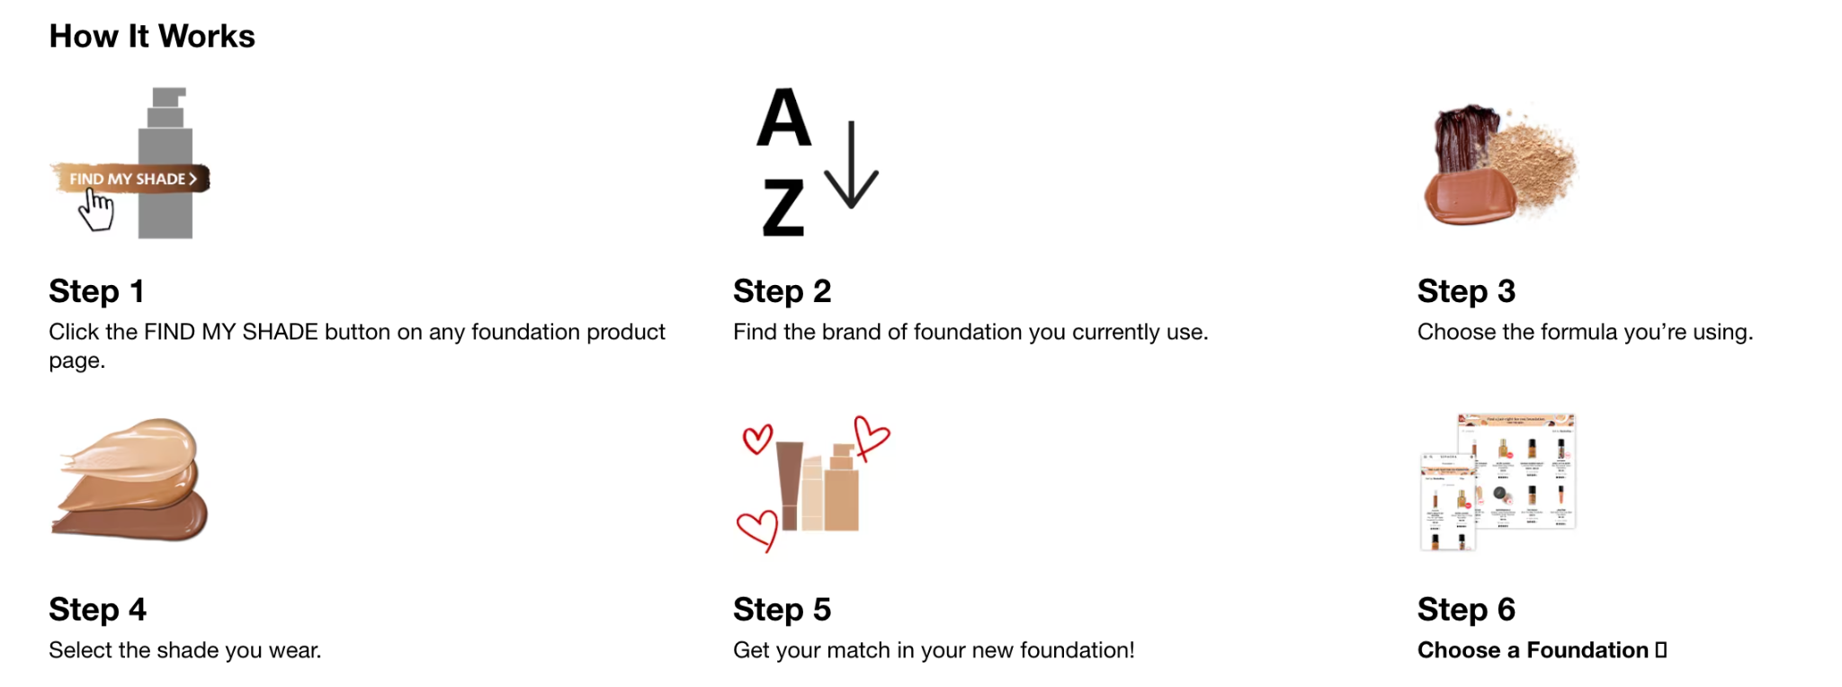
Sephora has tried to address bringing accessibility to foundations to all skin tones
However, this method doesn’t address the lack of skintone representations within brands, and therefore does not address an underlying inequality that exists in accessibility to makeup brands

Slide 5
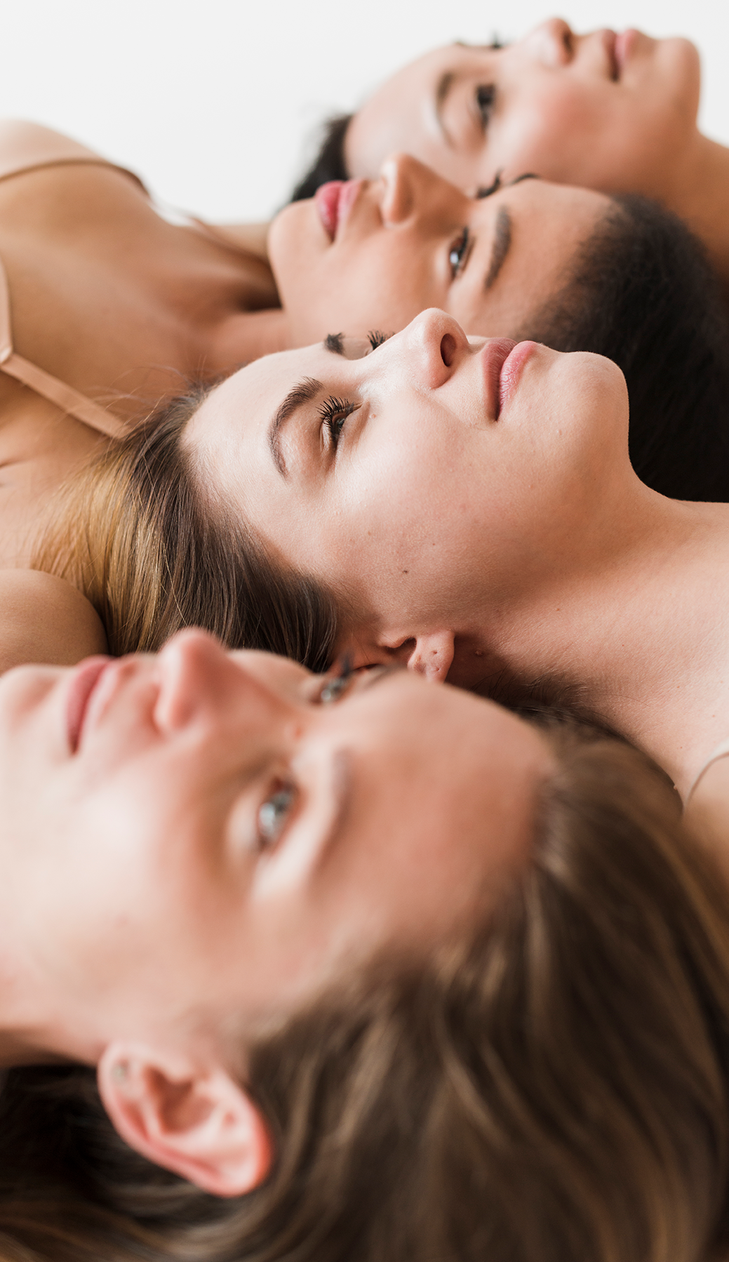
Our Research Question:
Given previous methods of addressing foundation inequality have failed to address the underlying inequities in brand-specific representation, can we create a methodology that helps individuals get a more accurate match in foundation within any brand?

Slide 6

Background
Skin Tones are on a gradient, not just categories!
Many individuals own many foundations, and already perform foundation mixing!
Gender Shades: Intersectional Accuracy Disparities in Commercial Gender Classification
IBM, Microsoft, and Face++
darker-skin shades vs lighter-skin shades

Slide 7
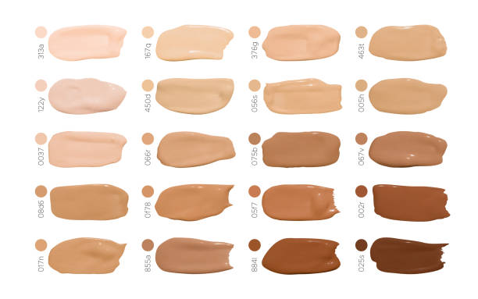
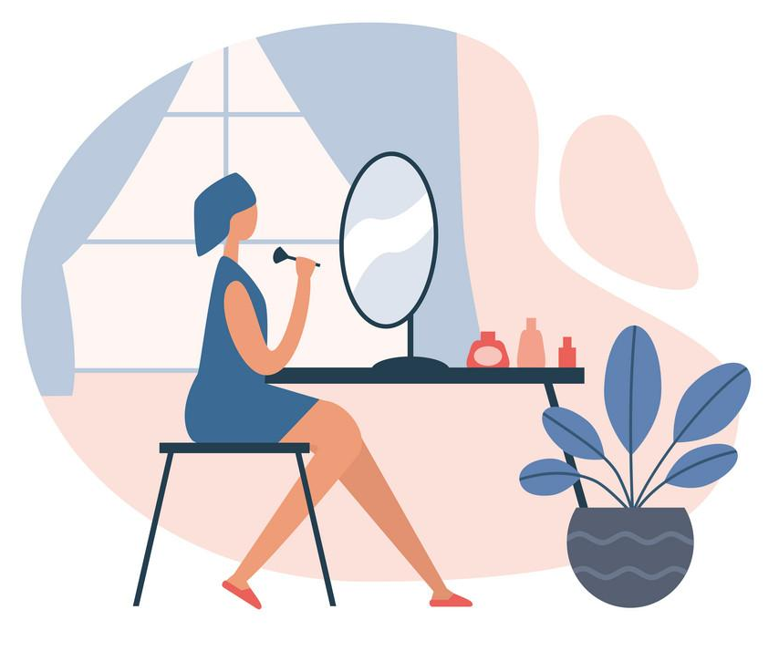

Our Approach to Rethinking Foundation Matching
Stage 1: Understand and Create the Computer Vision- based skin-tone detection
Stage 3: Mini study of testing outputs ourselves
Stage 2: Creating a ShadeFusion Matching Algorithm

Slide 8
02
Understanding the Data

Slide 9
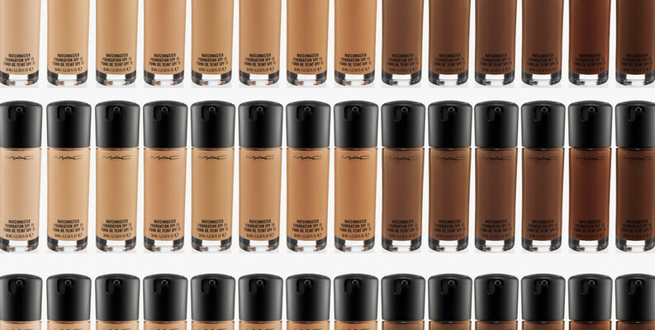
Makeup Shades Dataset
Source: Kaggle
Purpose: Analyze global foundation shade availability to promote inclusivity.
Data: Compiled from bestsellers in the US, Nigeria, India, and Japan, categorized for BIPOC inclusivity labeled from group 0-7 based on color range, brand info, hex, h, s, l, v description of product.
Use: Algorithm training and bias detection.

Slide 10
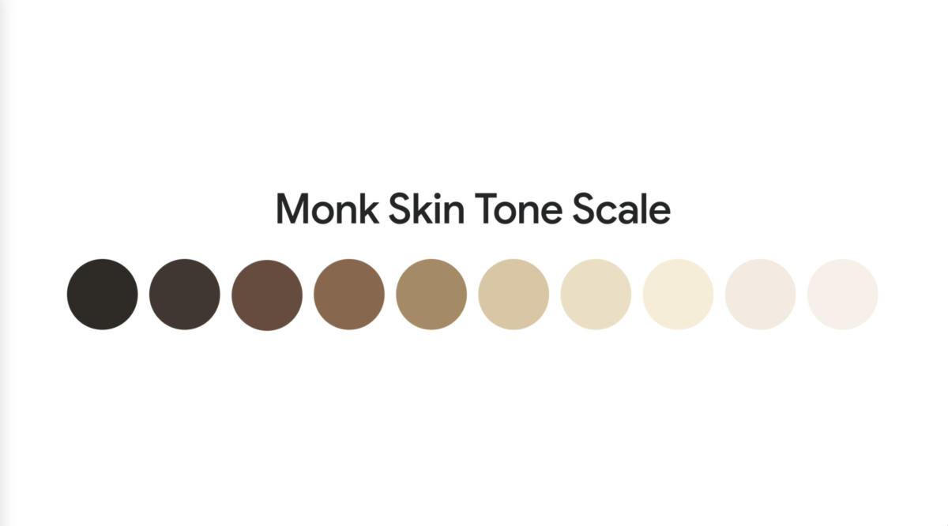
Monk Skin Tone Examples - Google AI
Source: Google AI
Purpose: Support equity in computer vision with accurate skin tone classification.
Data: Images of 19 individuals with 1570 files total, with accurate representation of skin tones across the Monk Skin Tone Scale, description of lighting, pose, mask and file type information in csv
Use: Skin tone classification and equity measurement.

Slide 11
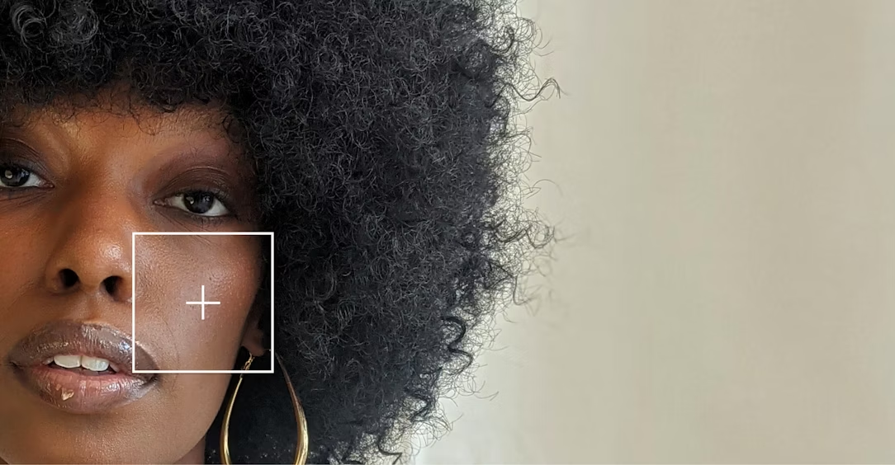
Key Objectives for Utilizing these Datasets
Makeup Shades Dataset: Utilized for algorithm training and bias detection, emphasizing shade inclusivity across demographics.
Monk Skin Tone Examples: Applied for Skin Tone Classification and Equity Measurement in Computer Vision, for fairer representation.
Aim to create fairer and more unbiased skin shade detection algorithms that cater to a globally and ethnically diverse consumer base.
These datasets help enhance the accessibility of cosmetics matching a broad spectrum of skin tones, reducing feelings of exclusion and promoting inclusivity and belonging.

Slide 12
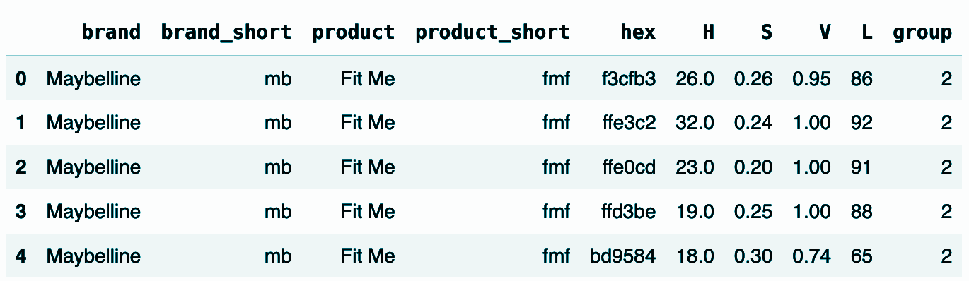
Understanding the Makeup Shades Dataset - I
Sensitive Features Considered: Hexadecimal color code (hex), hue (H), saturation (S), value (V), lightness (L), and group (group) are analyzed.
Impact on Makeup Shade Perception: Hex codes influence shade appearance, while H, S, V,L affect color perception and suitability.
Inclusivity Implications: Variations in these features impact makeup shade match and inclusivity across diverse demographics.
Bias in Shade Grouping: Grouping by brand, country, or recommendations reflects biases and preferences, affecting shade availability and suitability for different groups.

Slide 13
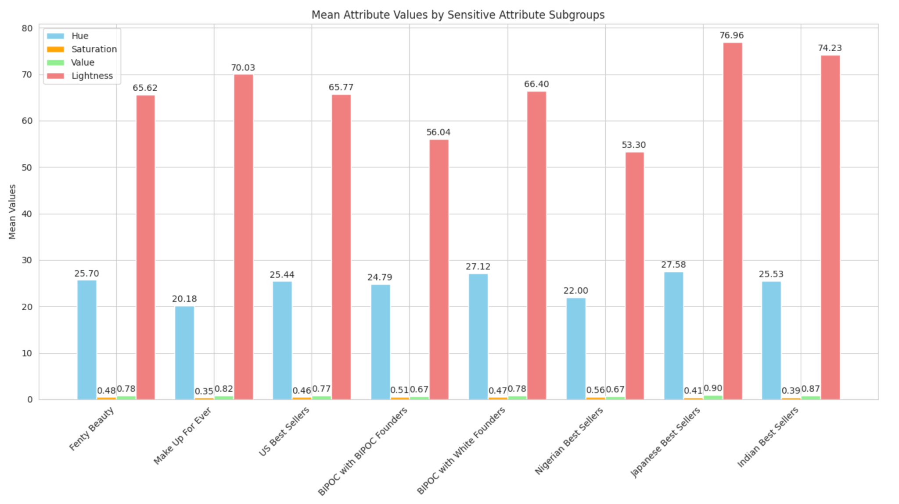
Understanding the Makeup Shades Dataset - II
Outcome variable stats detail the average color properties and variability.
Analyzing within Sensitive Attribute Subgroups reveals patterns and disparities in makeup shade offerings across demographics and brands.
Eg. BIPOC-recommended brands show broader hue range and lower median lightness, indicating better representation of darker skin tones.
Eg. Regional best sellers focus more on lighter shades, reflected in higher median lightness values.
Illuminates biases in makeup shade availability, enhancing inclusivity in the beauty industry.

Slide 14
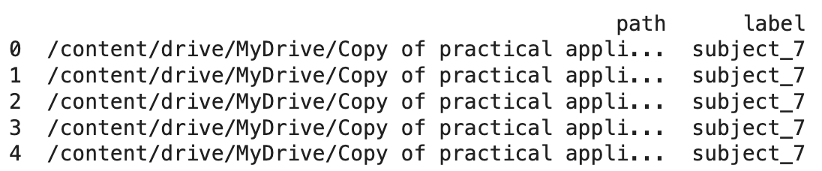
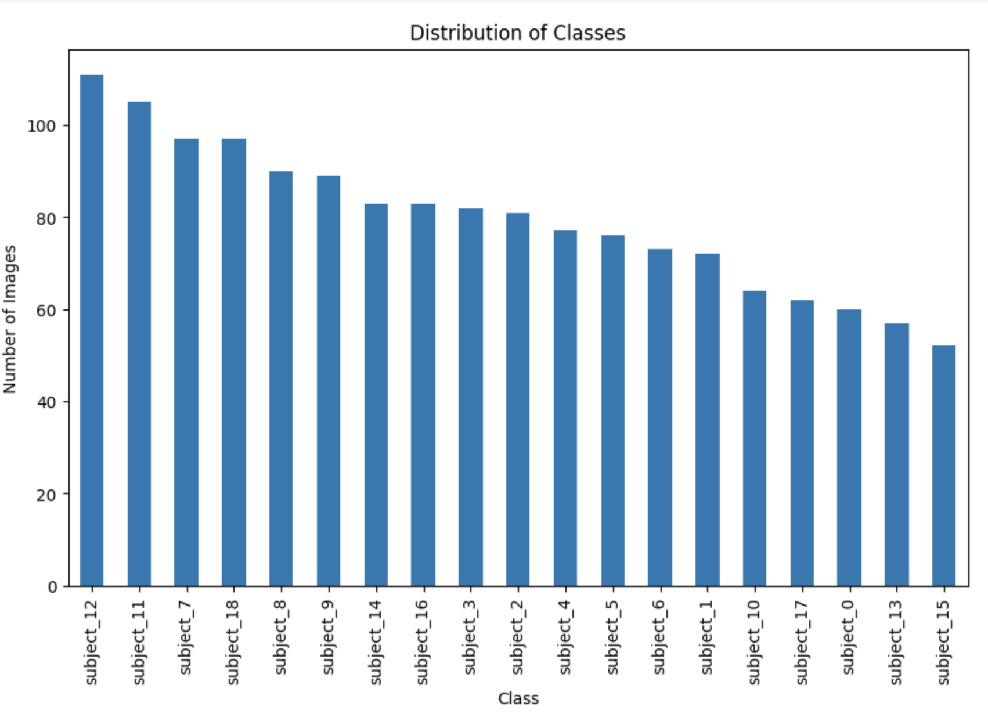
Understanding the Monk Skin Tone Dataset
Distribution of Images by Subject:
Reveals varying numbers of images per subject in the dataset.
Observations:
Subject 12, with very dark skin shade, has the highest number of images.
Subject 15, with lighter skin color, has the fewest images.
Hypothesis:
Dataset bias towards darker skin tones may contribute to more comprehensive training data.
Expectation that models trained on this data will exhibit greater fairness and accuracy across skin tones.

Slide 15
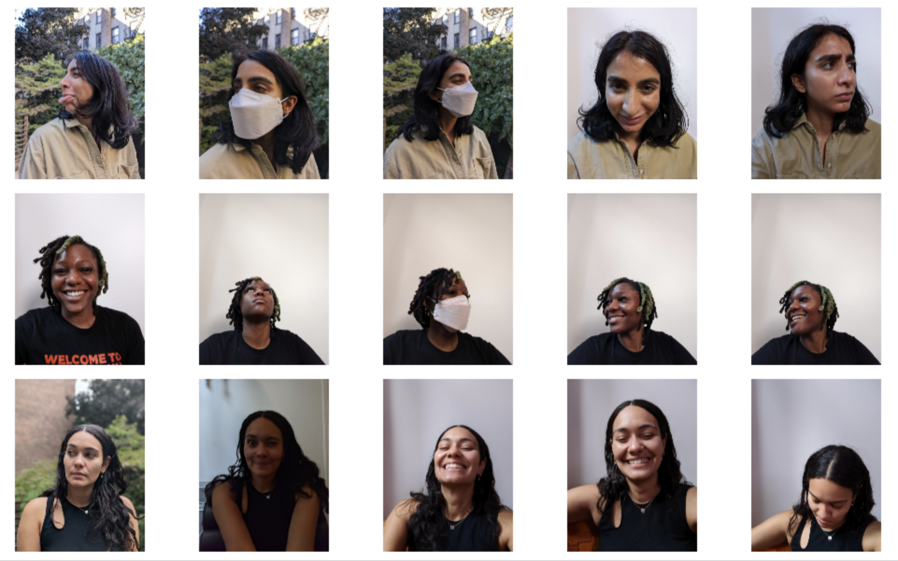
Understanding the Monk Skin Tone Dataset - Data Cleaning
Removed File Types: Dropped all .gif and .mp4 files, as they were incompatible with our computer vision algorithm.
Excluded Images with Poor Conditions:
Poor Lighting: Removed to ensure accurate skin color detection.
Masks and Obstructive Poses: Deleted images with masks or poses showing side ( initially tested to check if it works with algorithm, removed later) and bottom views, which hinder full-face visibility.

Slide 16
03
Methods

Slide 17
01
Create the Computer Vision-based skin-tone detection
Stage

Slide 18
Stage 1 Methodology:
Testing 2 Different Approaches to Detecting Skin Tone From Images
Portrait picture of person is taken in well lit lighting
Skin Tone Detection Algorithms are analysed:
Cheek Patch Detection Skin Tone Algorithm
Face Segmentation Mask Skin Tone Algorithm
3. Detected Skin Tone is matched to closest shade in the Makeup shades dataset
to assess how diverse the shade options are for different skin tones by
calculating Euclidean Hex Distance as the error

Slide 19
Computer Vision Shade Detection and Matching Hypotheses 1:
01
Hypothesis:
Targets cheek areas, reducing bias from tattoos and pigmentation."
"Full-face algorithms can misrepresent skin shade due to facial features and pigmentation."
"Darker skin and low lighting increase error rates in foundation matching."
Cheek Patch Skin
Tone Detection

Slide 20
Computer Vision Shade Detection and Matching
Hypotheses 2:
02
Hypothesis:
Ensures better uniformity and control in skin tone analysis and enhances accuracy by excluding non-skin areas
"Facial hair and irregularities impact shade accuracy in skin detection."
"Side poses affect facial landmark accuracy, impacting skin segmentation."
Face Segmentation Mask Skin Tone Detection

Slide 21
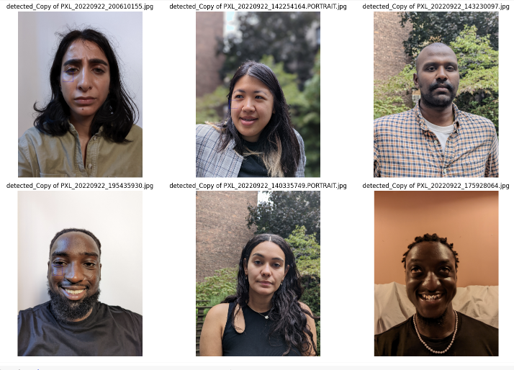
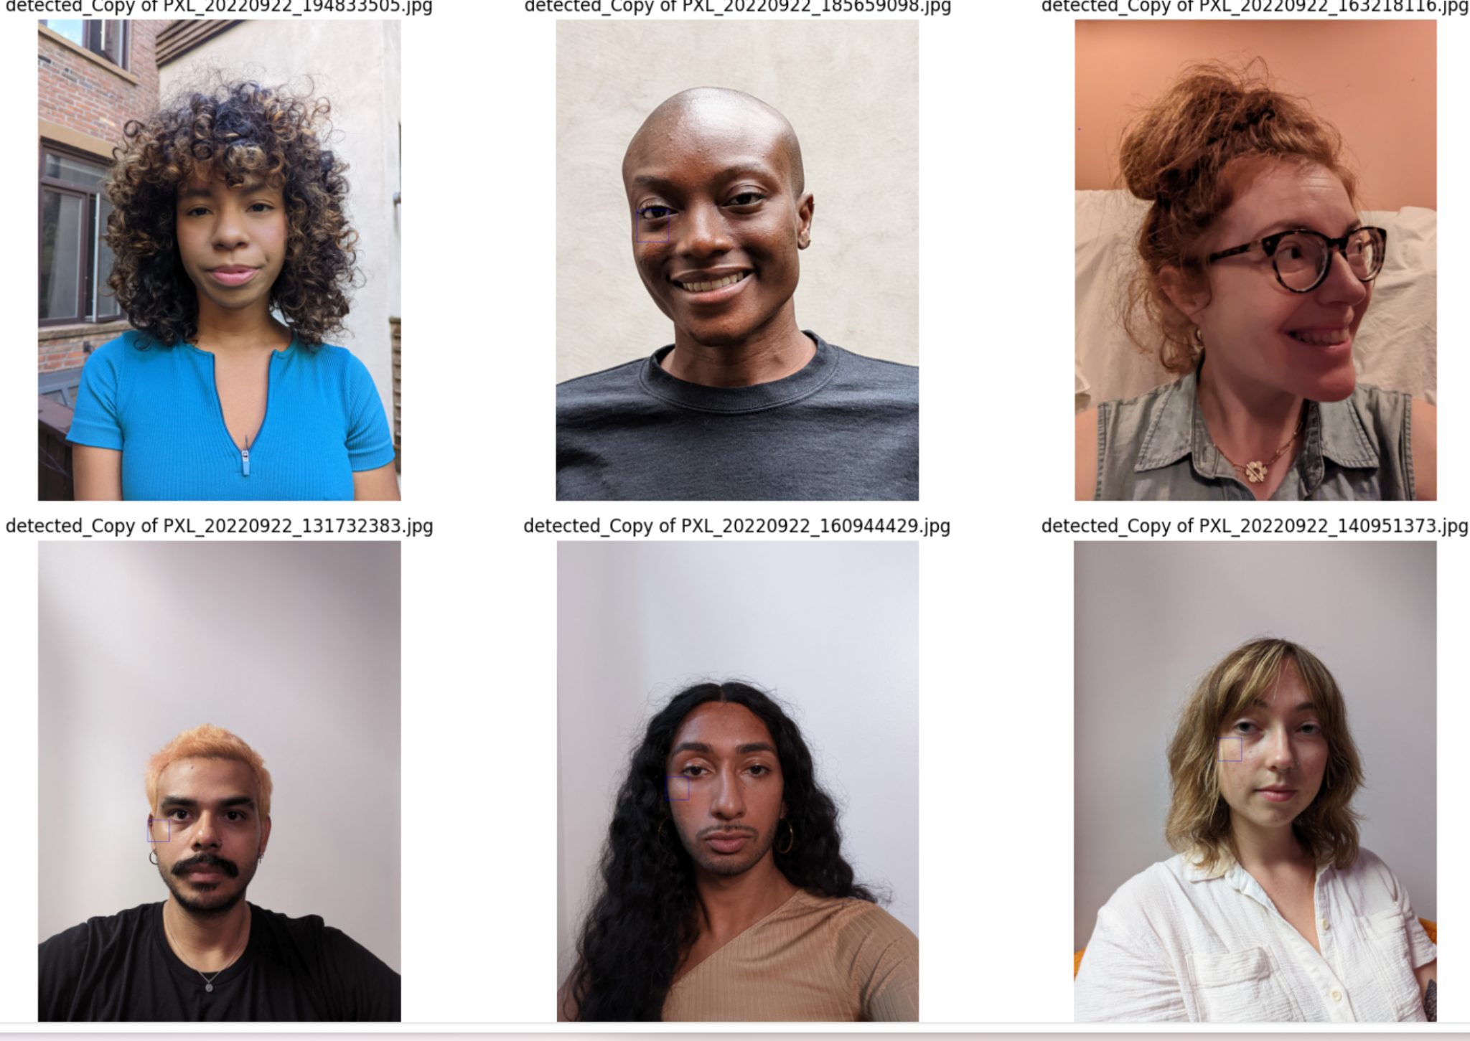
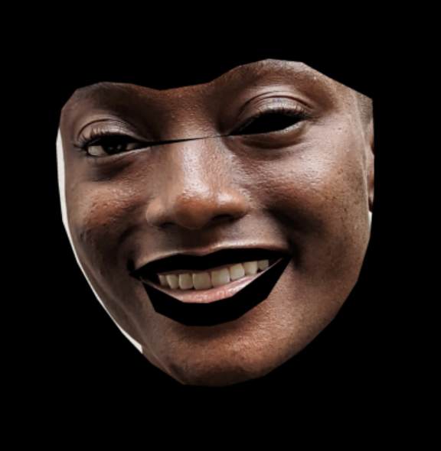
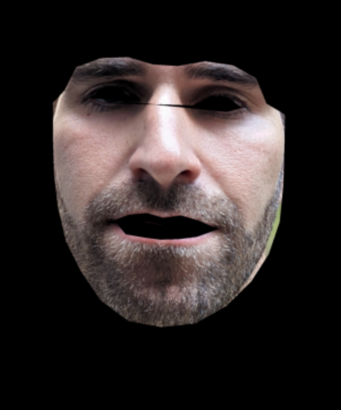
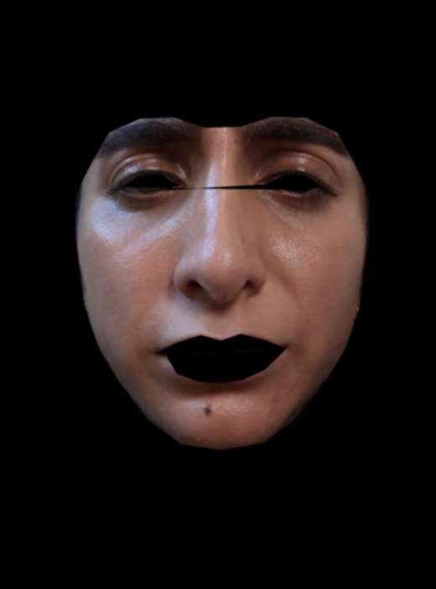
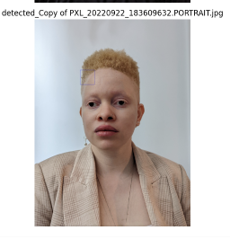
MST-E Dataset
Cheek Patch
Detection Algorithm
Using
OpenCv Cascade Classifier
Face Segmentation
Mask Algorithm
Using
Dlib’s 68 face landmarks

Slide 22
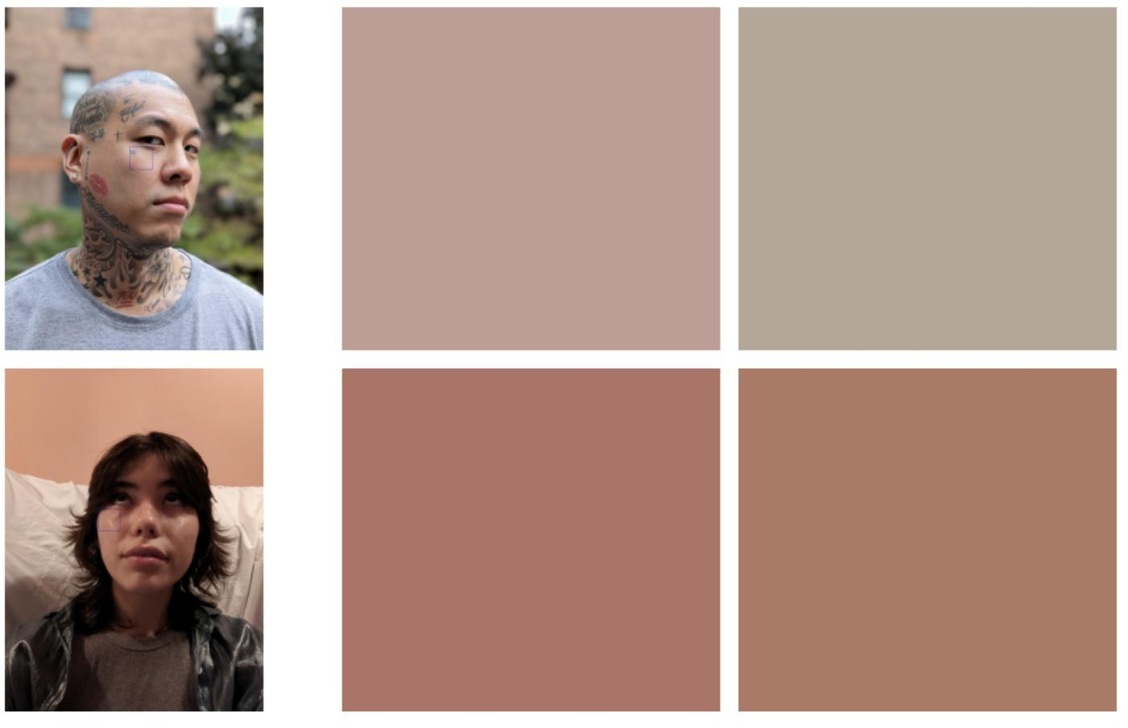
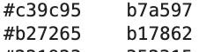
Cheek Patch Detection Algorithm
Detected Matched

Slide 23
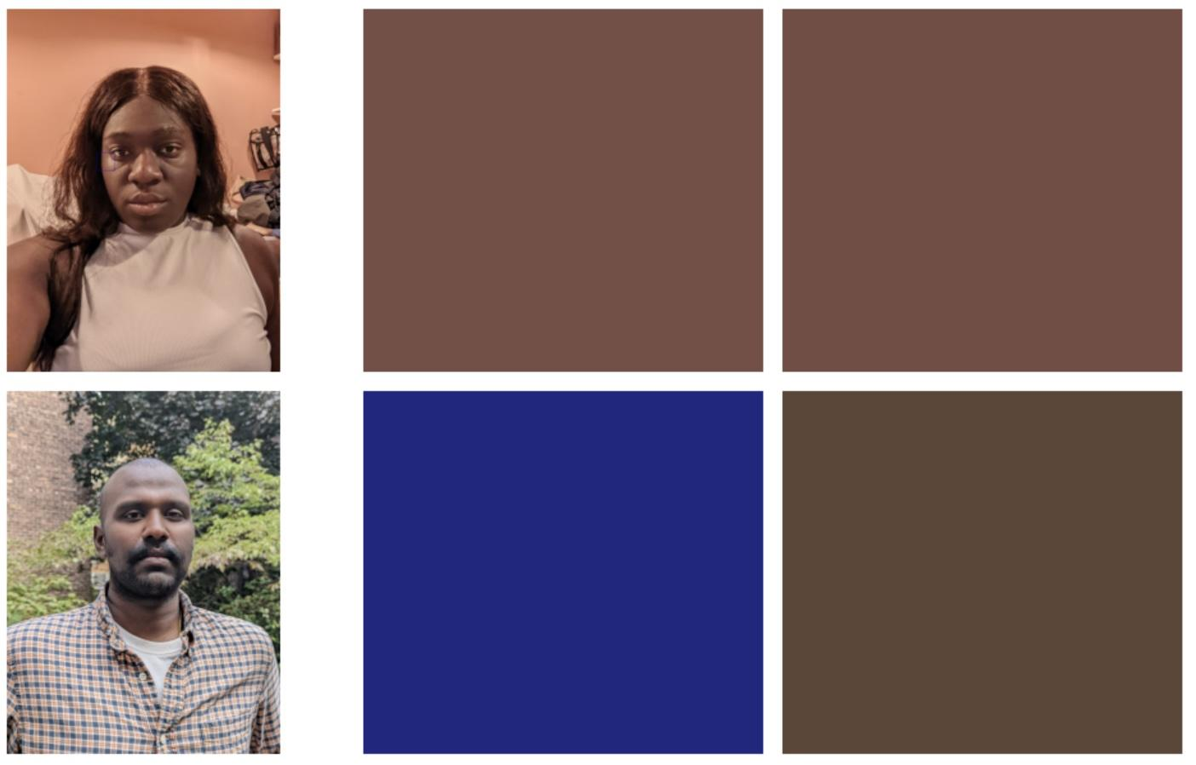
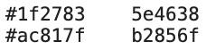
Detected Matched

Slide 24
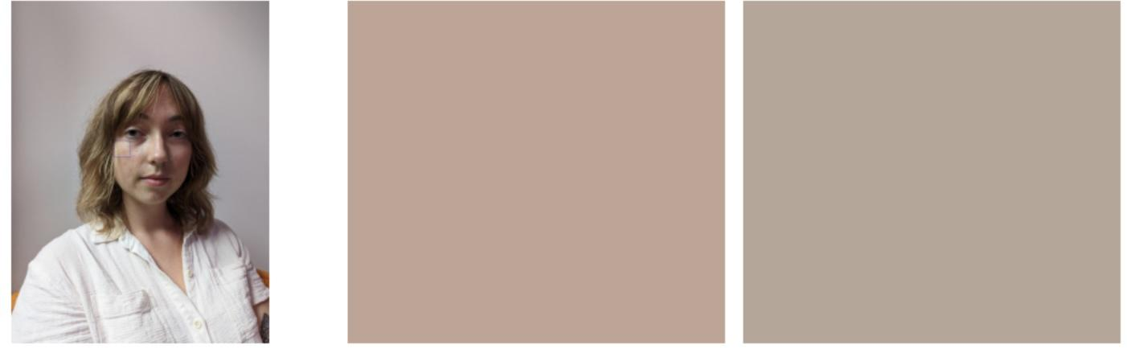
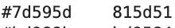
Detected Matched

Slide 25
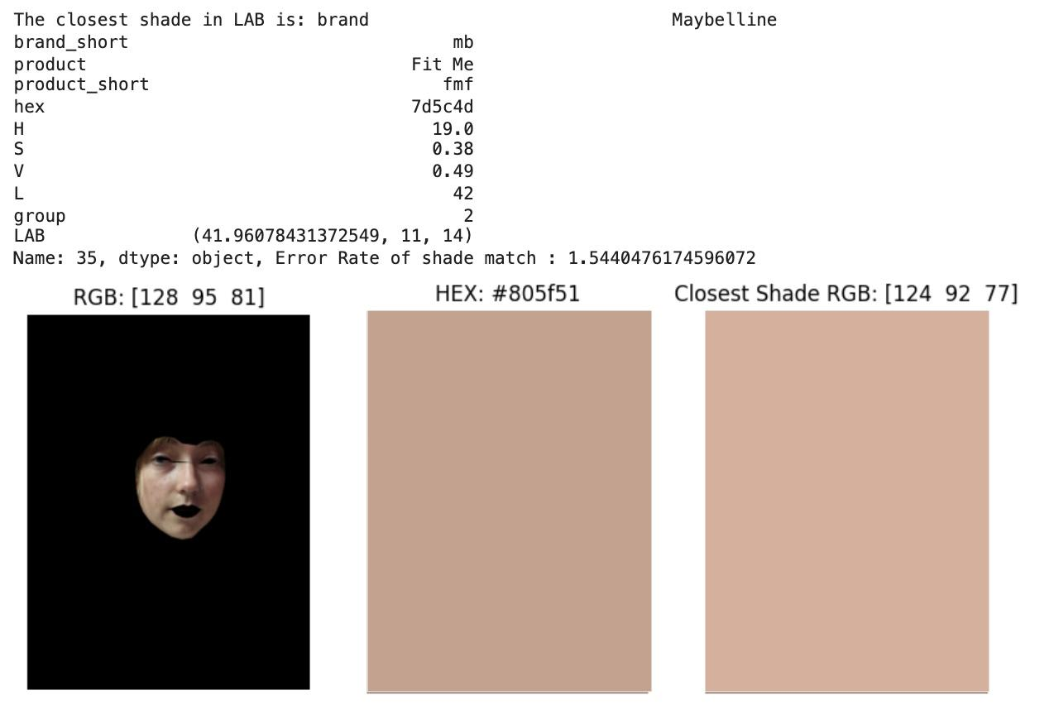
Face Segmentation Algorithm

Slide 26
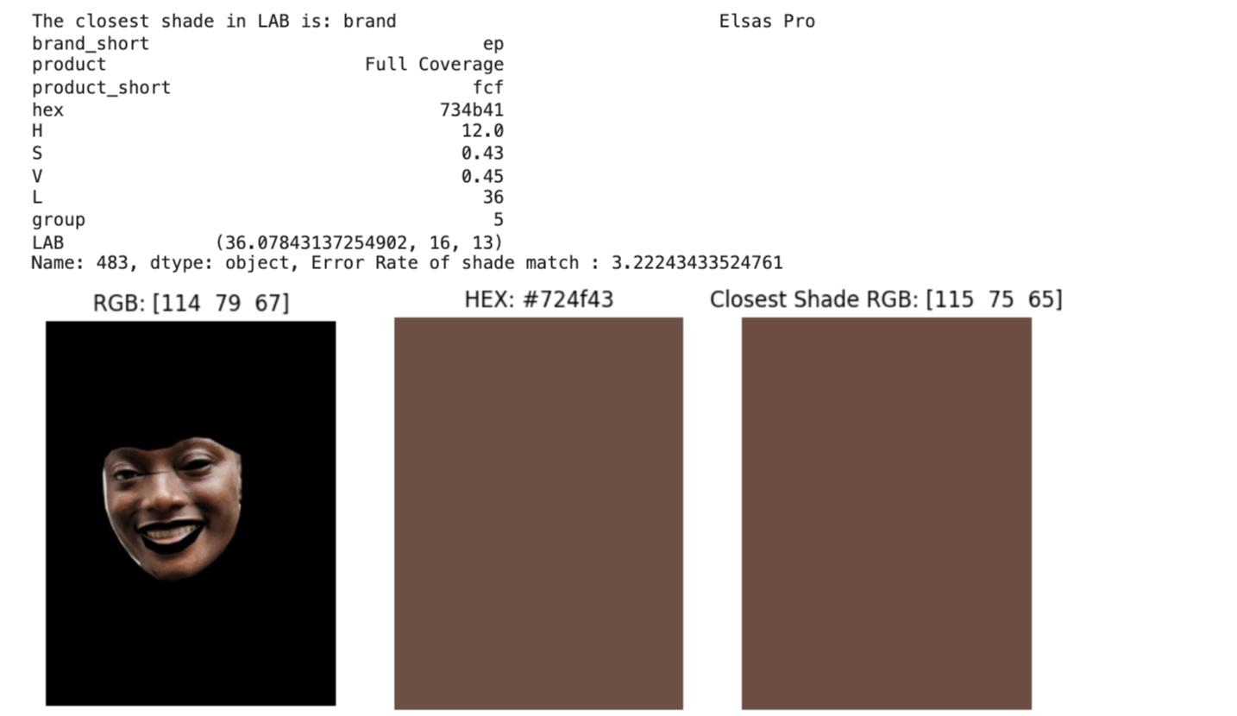

Slide 27
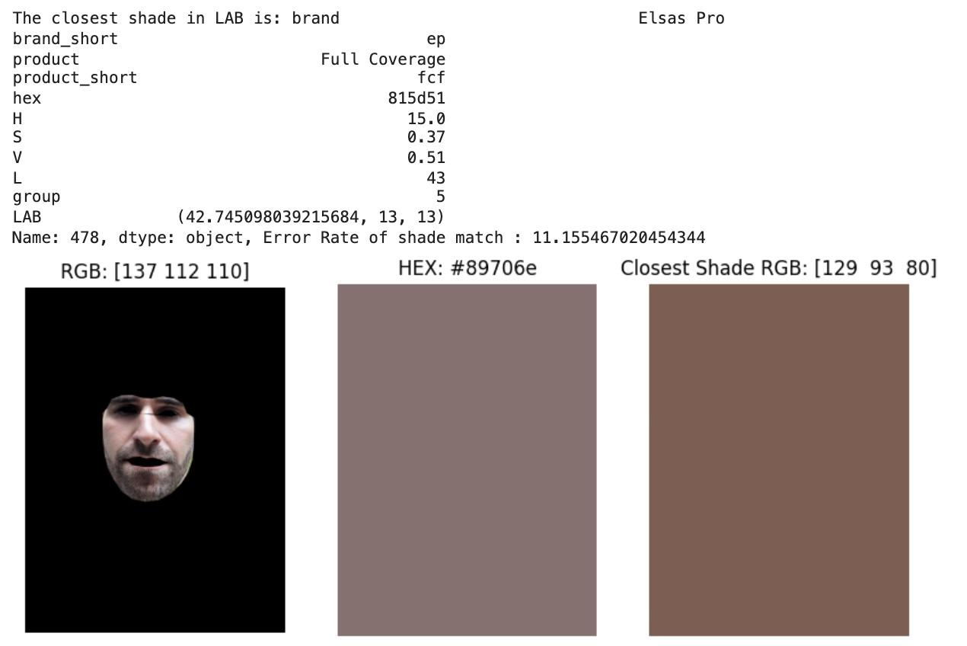

Slide 28
02
ShadeFusion Matching Algorithm
Stage

Slide 29
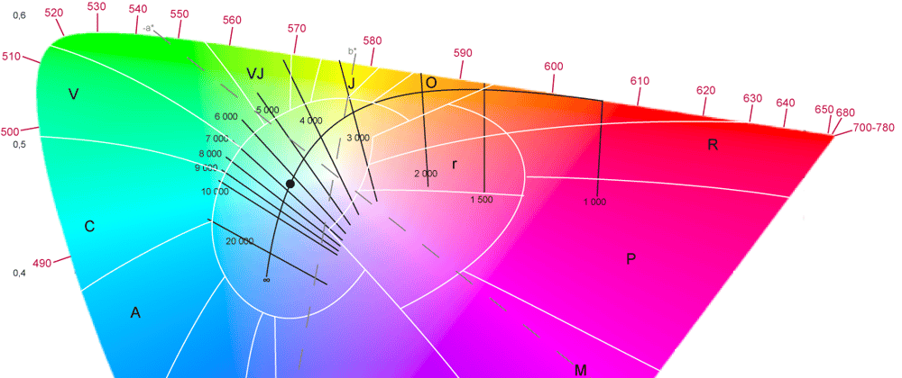
Our Approach to ShadeFusion
Hypothesis: Based on the foundations that are available in the market mixing two shades within the same brand will produce a better foundation match than choosing one specific foundation within a brand for varying individual’s skin tone
How Do we Measure a ‘Match’: Euclidean Hex Distance

Slide 30
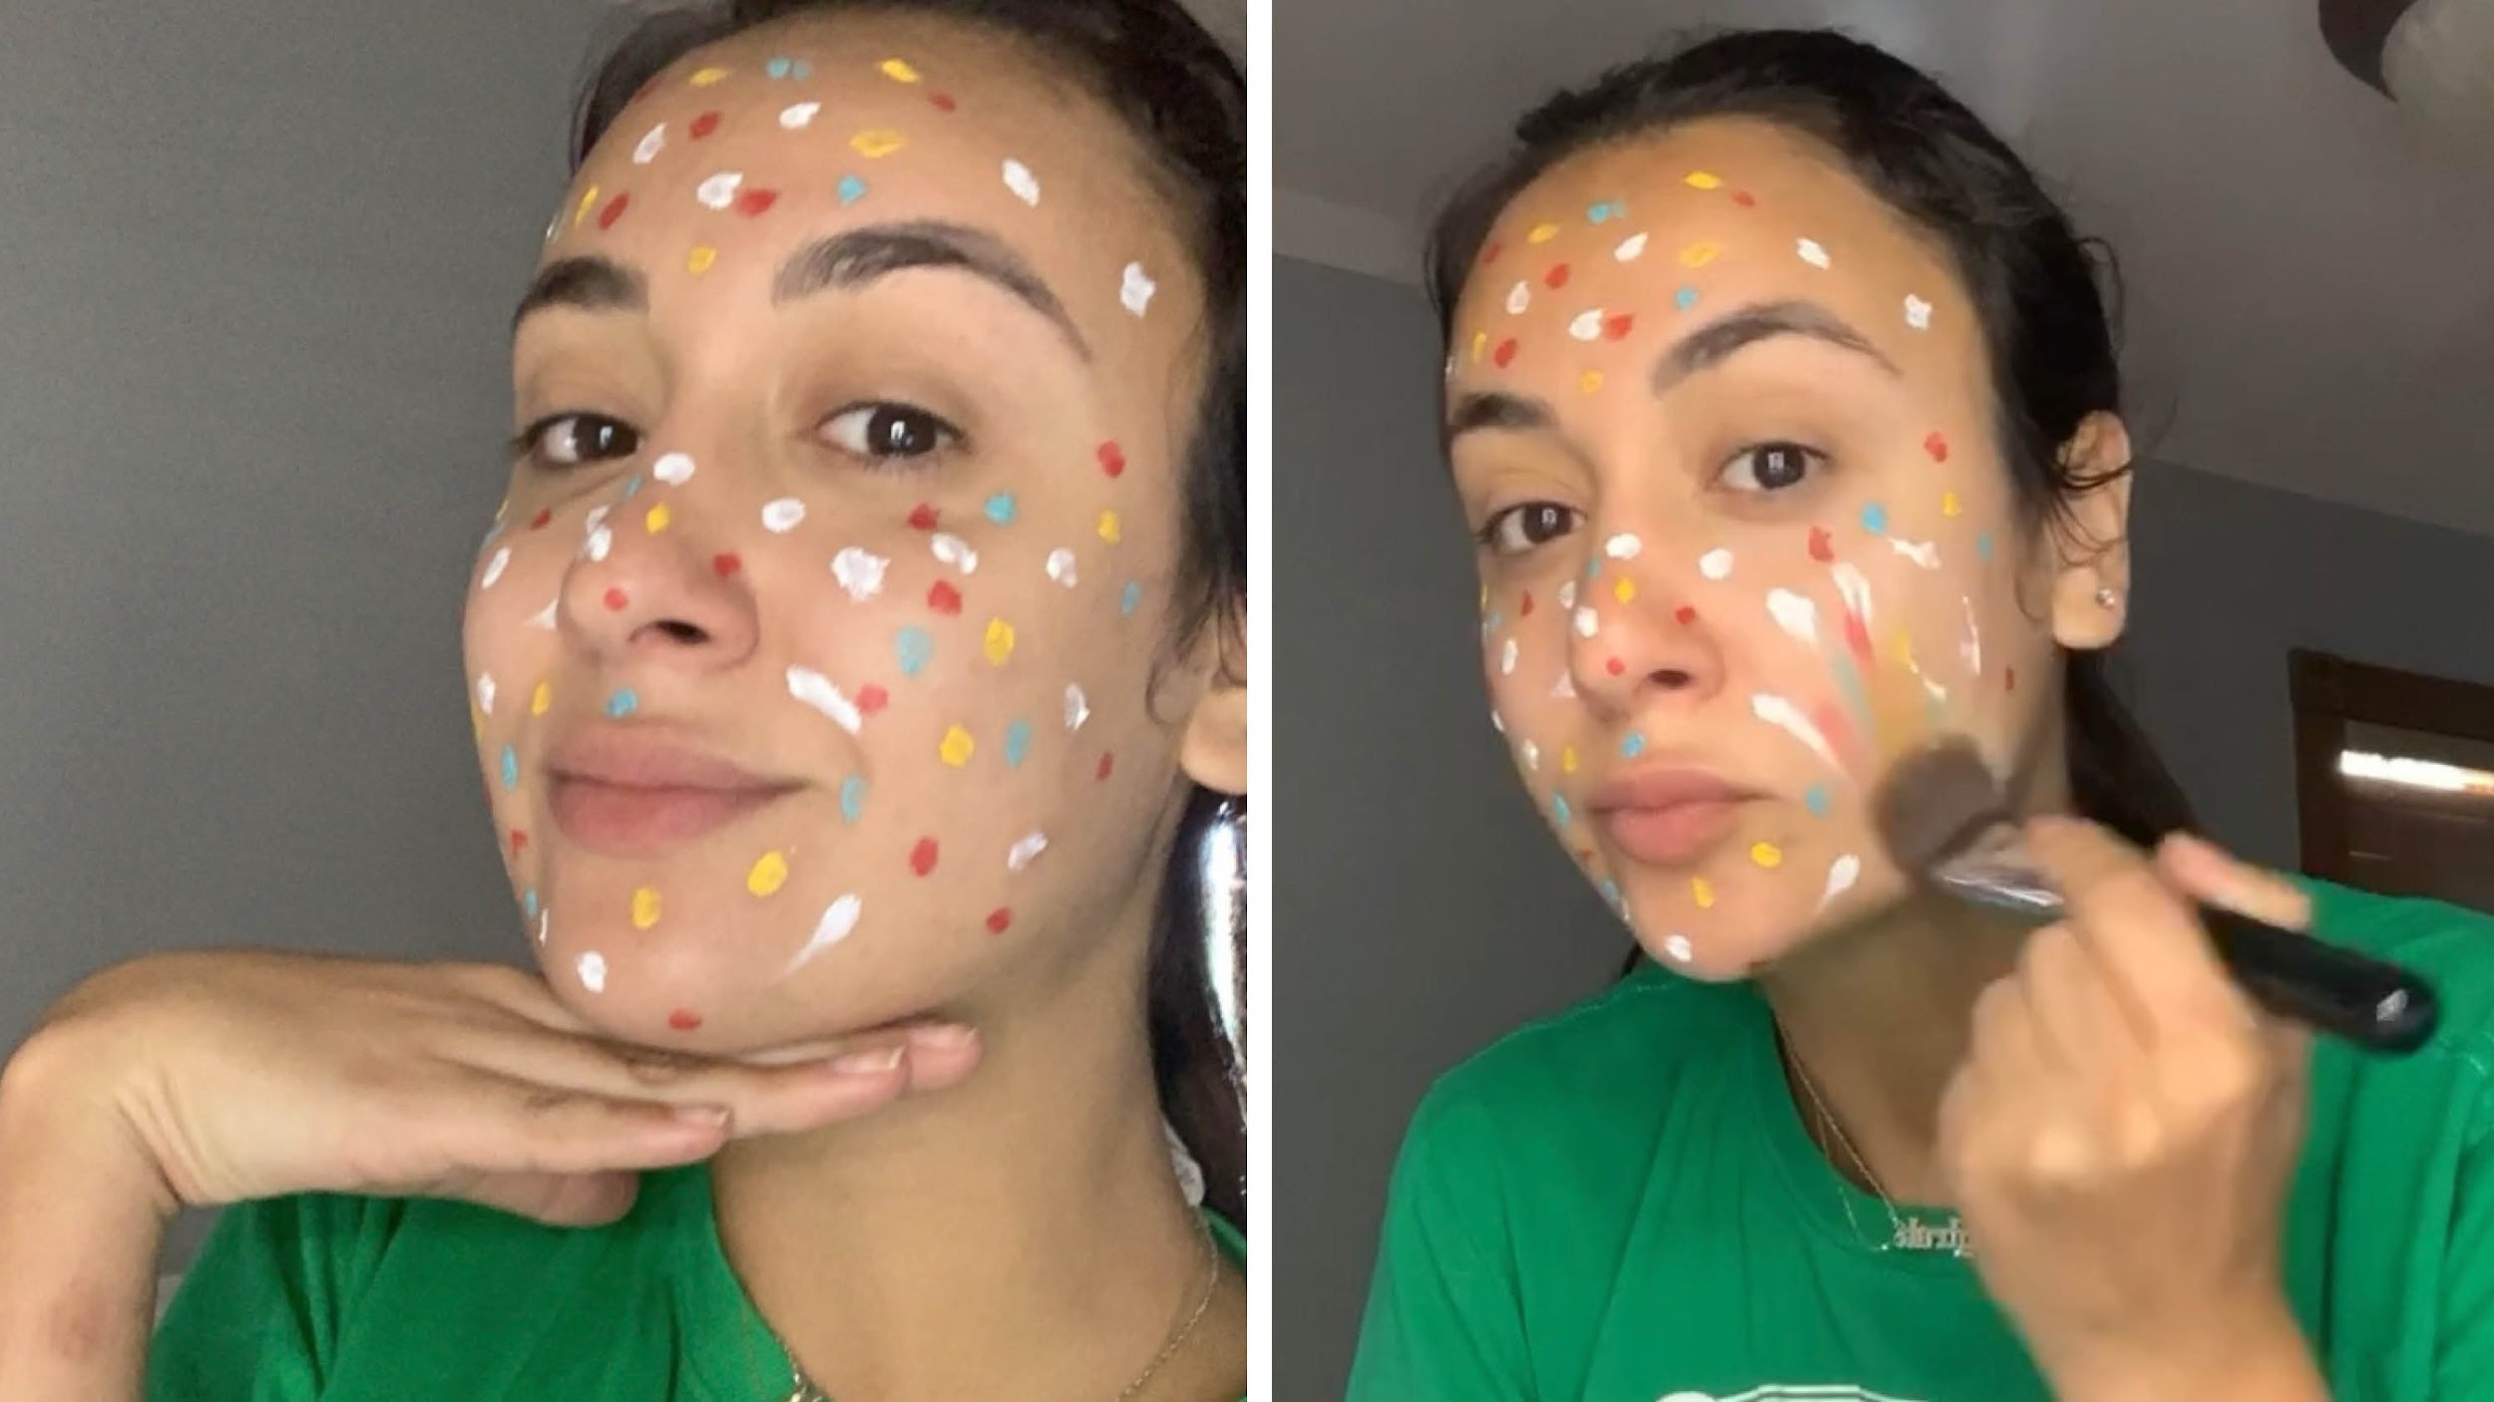
ShadeFusion Methodology
Determine the right representation of ‘color’ for both skin tone and foundation pigments
Pick a target brand
For each skin tone, find the closest 1-1 match
For each skin tone, find the closest 2-1 match
Iterate through .1 proportions of foundation
Calculate the Euclidean Distance of created foundation pigment from true skin tone color

Slide 31

Comparing 1-1 Match to ShadeFusion Match
Error Distance = 15.74
Error Distance = 1.41
Best 1-1 Match
Target Skin Tone
Best 2-1 Match

Slide 32
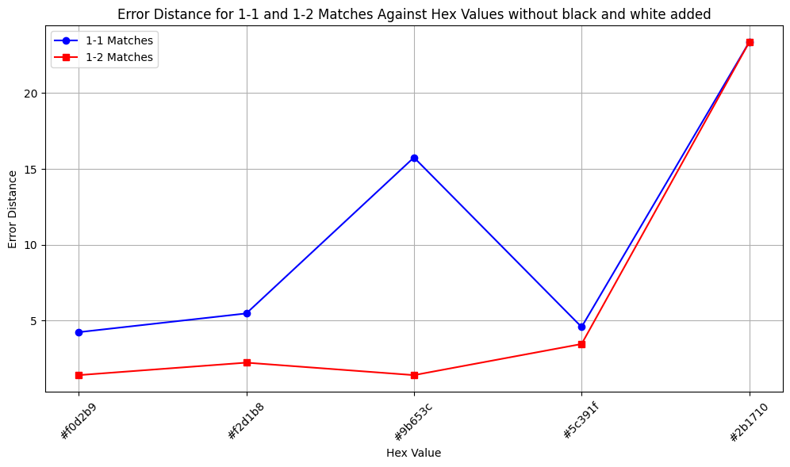
Understanding Initial Results For ShadeFusion
Though we saw a reduction in error distance, the darkest skin tone still had a high error rate.
LEARNING
There was a lack of representation of foundation shades darker than skin tone to mix.

Slide 33
ShadeFusionBW:
Editing our Approach to SkinFusion
Hypothesis:
Adding the shades pure black and pure white to a brand will increase the accuracy of ShadeFusionBW compared to ShadeFusion, and the regular 1-1 foundation matches for darker skin tones
Determine the right representation of ‘color’ for both skin tone and foundation pigments
Pick a target brand
Add Black and White to Target Brand Pigments
For each skin tone, find the closest 1-1 match
For each skin tone, find the closest 2-1 match
Iterate through .1 proportions of foundation
Calculate the Euclidean Distance of created foundation pigment from true skin tone color

Slide 34
04
Results

Slide 35
Results and Interpretations
Computer Vision based Skin tone detection and matching
Results were interpreted based on error rate which was calculated by euclidean hex distance calculation
Cheek Patch Detection Algorithm
Overall error: 7.52247341543291
Face Segmentation Algorithm
Overall error: 4.6001299816876555

Slide 36
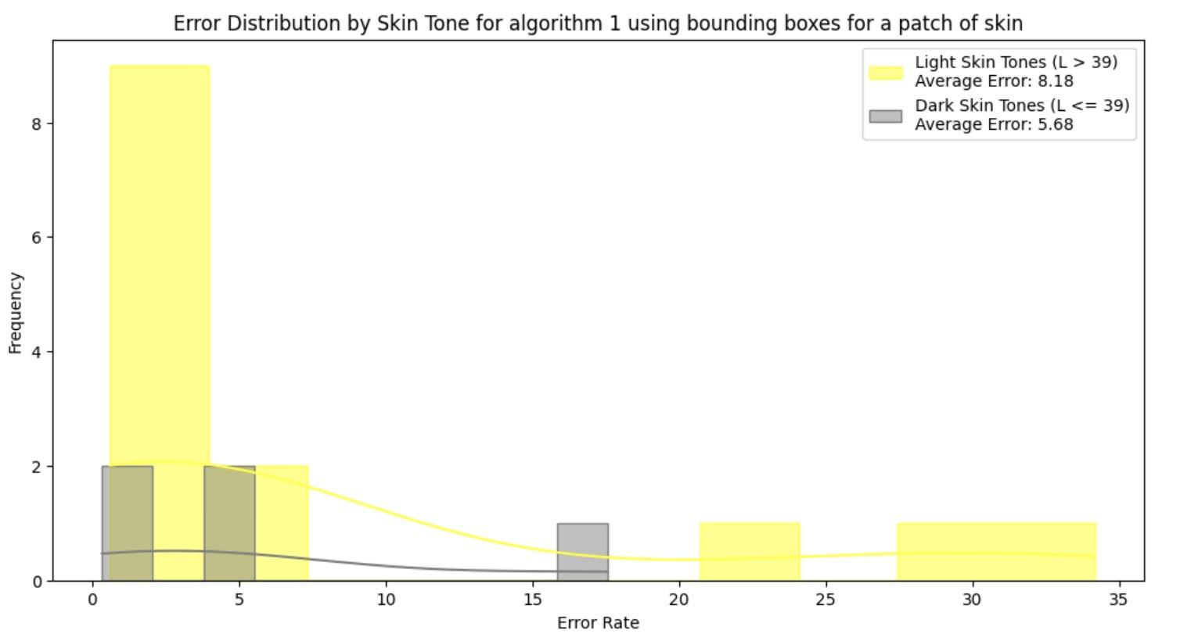
Results for Stage 1: Cheek Patch Detection Algorithm

Slide 37
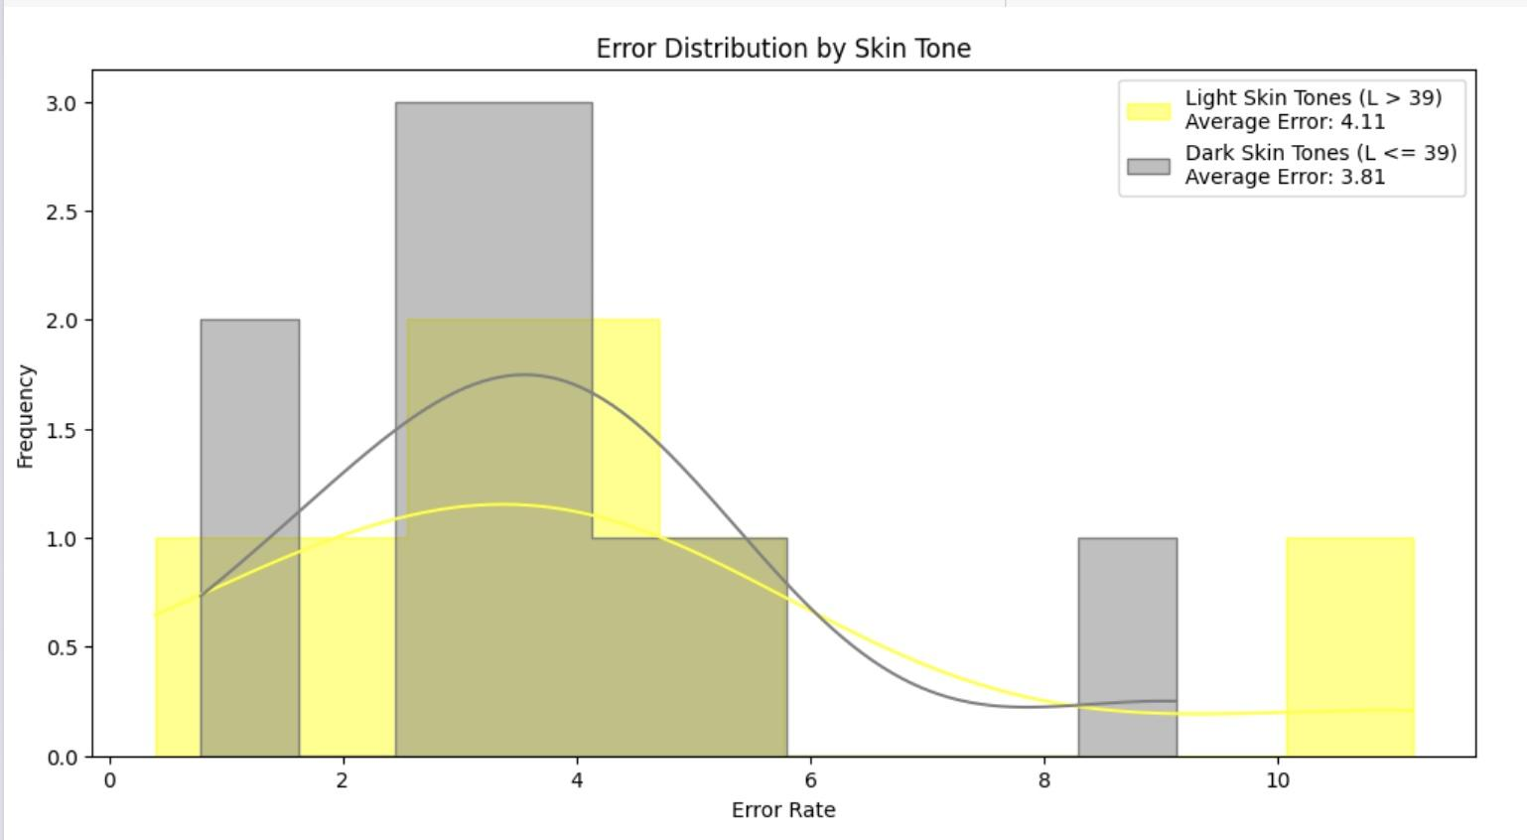
Results for Stage 1: Face Segmentation Algorithm

Slide 38
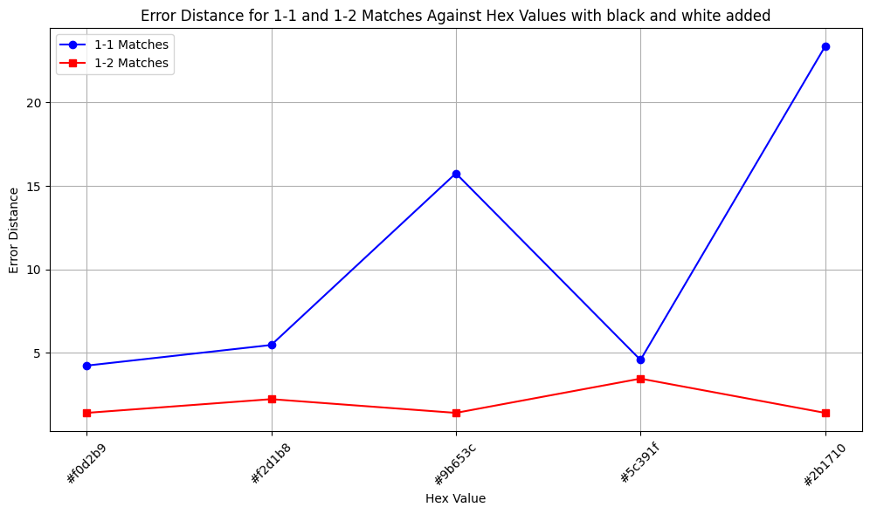
Results for ShadeFusionBW
LEARNING
The Error Rate for the darkest skin tone significantly decreased!

Slide 39
04
Interpretation

Slide 40
01
Interpreting the Results for Stage 1
Stage

Slide 41
Interpretation:
Algorithm 1 Analysis:
Objective: Detect bounding boxes in the cheek area to assess skin tone.
Issue: Misplacement in 6 of 19 cases led to detection of incorrect colors (blues, purples) due to hardcoded coordinates.
Improvement in Algorithm 2: Uniform skin canvas enhanced shade approximation.
Challenges with Algorithm 2:
Underperformance Factors: Struggled with side poses, facial hair, and smiling expressions.
Unexpected Finding: Lighter skin tones showed higher error rates than darker tones, potentially reflecting dataset bias with a predominance of people of color.

Slide 42
Results with respect to hypothesis
"Cheek Patch Detector targets cheek areas, reducing bias from tattoos and pigmentation."
"Full-face algorithms can misrepresent skin shade due to facial features and pigmentation."
"Darker skin and low lighting increase error rates in foundation matching."
"Segment Mask algorithm enhances accuracy by excluding non-skin areas as well as ensures better uniformity and control in skin tone analysis."
"Facial hair and irregularities impact shade accuracy in skin detection."
"Side poses affect facial landmark accuracy, impacting skin segmentation."

Slide 43
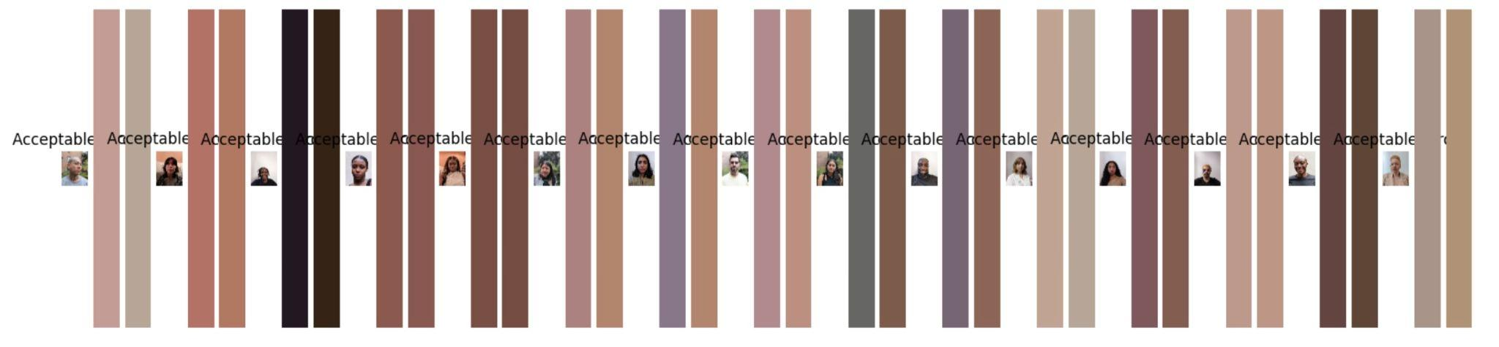
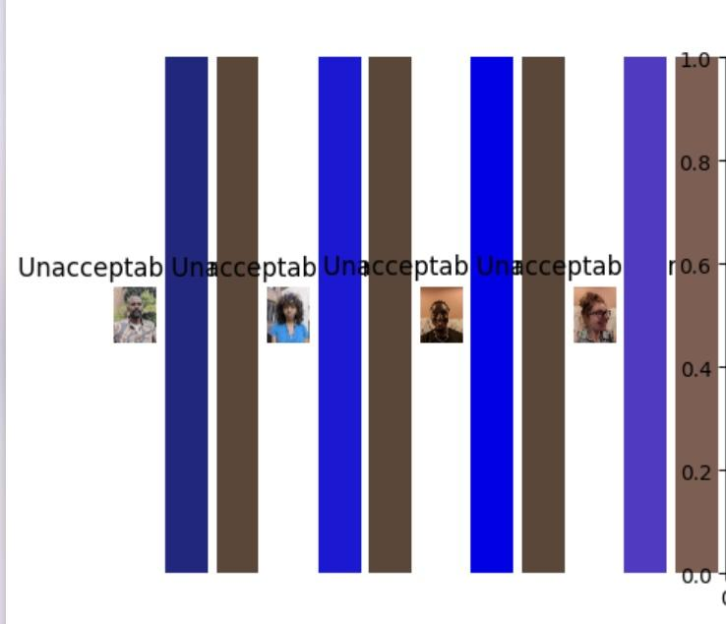
Discrepancies from Cheek Skin Detection Algorithm

Slide 44
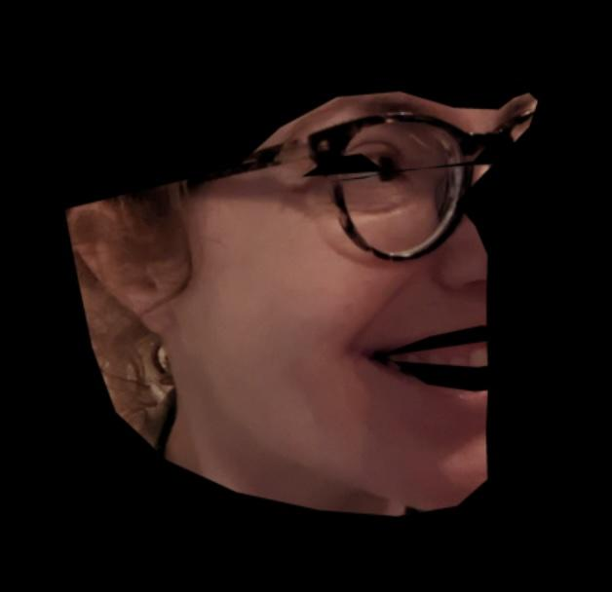
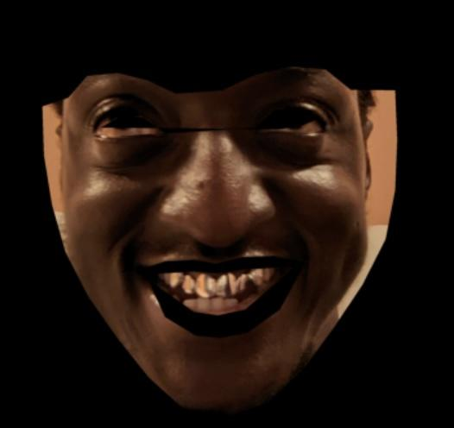
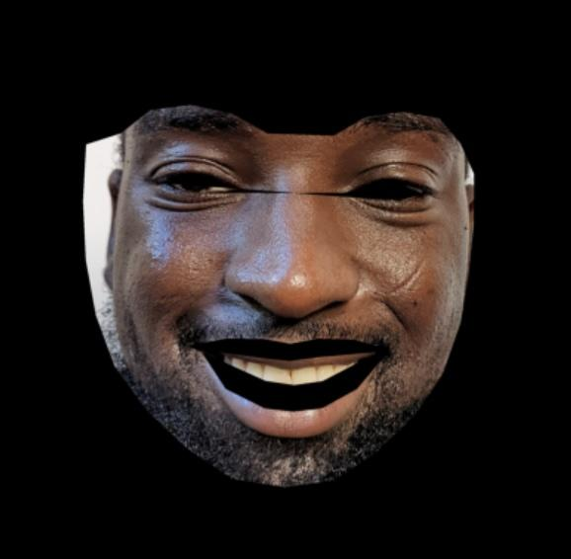
Discrepancies from Face Segmentation Algorithm

Slide 45
02
Interpreting the Results for Stage 2
Stage

Slide 46
Leveraging Color Theory to Increase Accuracy of Foundation Shade Matching is Key!
There is an underrepresentation of darker skin tones in foundation brands
This results in even the SkinFusion to not work
Drives us to further find a methodology to address these inequalities in makeup
By simply introducing black and white to any foundation brand, we can reduce the error distance significantly for darker skin tones.
Our hypotheses that SkinFusionBW would outperform a 1-1 foundation matching across various skin tones is accepted!

Slide 47

Study Limitations
Data Availability and Quality
Biases in Data
Subjectivity in Skin Tone Matching
Technological Constraints

Slide 48
Conclusion
Using color theory, we are able to address equity in brands
Computer Vision models need to account for variations in skin texture
Brands should offer pure black and white shades in their formulations

Slide 49
Contributions
Kimia - Introduction, Background, and Study Limitations
Priyanshi - Data
Harshini - Stage 1 Methods, Results, Interpretation
Dillanie - Stage 2 Methods, Results, Interpretation, Conclusion

Slide 50
Sources
[1]Buolamwini, J. and Gebru, T. (2018) Gender shades: Intersectional accuracy disparities in commercial gender classification, PMLR. Available at: https://proceedings.mlr.press/v81/buolamwini18a.html?mod=article_inline (Accessed: 15 April 2024). [2] What is CIELAB Color Space? https://www.hunterlab.com/blog/what-is-cielab-color-space/#:~:text=CIELAB%20or%20CIE%20L*a,change%20humans%20see%20between%20colors.
[3] Colorizer - Color picker and converter (RGB HSL HSB/HSV CMYK HEX LAB): https://colorizer.org/.
[4] OpenCV: Cascade Classifier: https://docs.opencv.org/3.4/db/d28/tutorial_cascade_classifier.html.
[5] Facial landmarks with dlib, OpenCV, and Python - PyImageSearch: 2021. https://pyimagesearch.com/2017/04/03/facial-landmarks-dlib-opencv-python/.
[6] Why are red, yellow, and blue the primary colors in painting but computer screens use red, green, and blue? 2015. https://www.wtamu.edu/~cbaird/sq/2015/01/22/why-are-red-yellow-and-blue-the-primary-colors-in-painting-but-computer-screens-use-red-green-and-blue/#:~:text=For%20additive%20color%20systems%20like,cyan.
[7] Seen vs. Screen - Sherwin-Williams: https://www.sherwin-williams.com/architects-specifiers-designers/education/project-profiles/sw-dir-article-seenscreen.
[8] Pujol, F.A., López, M.P., Jimeno-Morenilla, A. and López, M.P. 2017. Face detection based on skin color segmentation using fuzzy entropy. Entropy. 19, 1 (Jan. 2017), 26. DOI:https://doi.org/10.3390/e19010026.https://www.mdpi.com/1099-4300/19/1/26

